Slide 1
PKI Components

Slide 2
Public Key Infrastructure (PKI)
Based on trust
Who can you trust?
“I trust him. He trusts her. Therefore I will trust her.”
Who do you trust in PKI? The Certificate Authority (CA)
Digital certificates are files that contain verifiable information proving an entity is who they claim to be
How do you verify? With the CA!
CA is organization that says “this is who they claim to be”
CA business is only good as long as they can be trusted

Slide 3
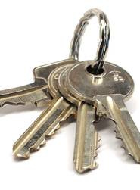
Key management
Key generation
Create key for user
Certificate generation
Allocate key to user (Nobody else can use that key)
Distribution
Make key available to users
Storage
Store and protect against unauthorized use
Revocation
Manage compromised keys (“Hey, don’t trust any of these old keys!”)
Expiration
Certificate might have a defined end of life

Slide 4
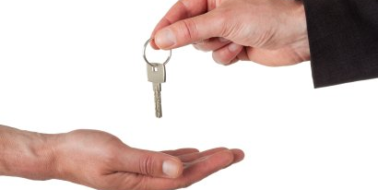
Certificate
Public key certificate
Links public key with a digital signature
Unique digital signature
Can be validated by a Certificate Authority
Certificates can be created by users

Slide 5
Digital certificate internals
Field | Contents
Version | The X.509 version supported (V1, V2, V3)
Serial Number | A number uniquely identifying the certificate within the domain of its CA.
Signature Algorithm | The algorithm used by the CA to sign the certificate
Issuer | The name of the CA, expressed as a Distinguished Name (DN)
Valid From | Date and time when the certificate began
Valid To | Date and time until the certificate expires
Subject | The name of the certificate holder, expressed as a Distinguished Name (DN)
Public Key | Public key and algorithm used by the certificate holder
Extensions | V3 certificates can be defined with extended attributes such as friendly subject or issuer names, contact email addresses, and intended key usage.

Slide 6
Extensions
Optional fields for added benefit
Extension | Description
Digital signature | Used to digitally sign documents
Non repudiation | Used by a non-repudiation service
Key encipherment | User for key exchange
Data encipherment | Used to make data confidential
Key agreement | Used for Diffie-Hellman key agreement
Certificate signing | Used by CA for certificate signing
CRL signing | Used to sign Certificate Revocation List
Encipher only | Used for Diffie-Hellman key agreement
Decipher only | Used for Diffie-Hellman key agreement

Slide 7
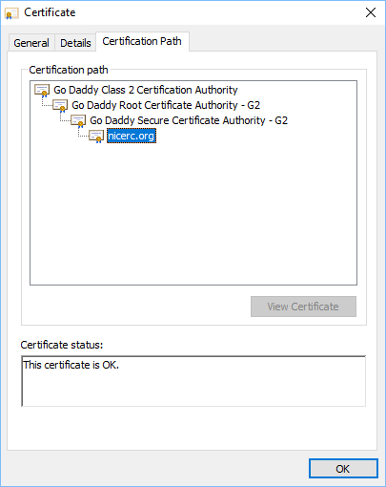
Commercial certificate authorities
Browser handles this automatically
Purchased web certificate
Enters public trust through CA
Create your own key and send to CA for signing
Issues Certificate Signing Request (CSR)
Different levels of trust and features
Add a new “tag” to your web site

Slide 8

Private certificate authorities
Be your own CA
Creates certificates and trust in-house
Needed in many organizations
Many internal servers and privacy requirements

Slide 9


PKI Trust Relationships
Single CA
Users receive certificates from one authority
Hierarchical
Single CA issues certificates to intermediate CAs
Easier to revoke an intermediate CA than root CA

Slide 10

Key Revocation
Certificate Revocation List (CRL)
CRL kept by Certificate Authority
Many different reasons
Changes all the time
April 2014 – Heartbleed
CVE-2014-0160
OpenSSL flaw put the private key of some web servers at risk
OpenSSL was patched every web server certificate replaced
Older certificates moved to the CRL

Slide 11

Getting revocation details to the browser
OCSP (Online Certificate Status Protocol)
Browser checks revocation status of certificate
Message sent to OCSP responder via HTTP
Uses existing web connections
Not all browsers use OCSP

